Slide 1

TOMP-API
Market consultation 2024
How does the TOMP API rank in the marketplace?

Slide 2

Overview
Rationale and approach
Research questions
Market sentiment
Recommendations
In conclusion

Slide 3
Rationale and approach
Reason
Governance and Management not yet sufficiently in place
Funding and resources are a recurring problem
Functional and technical market needs
National vs. International
Raison d’etre?
How to proceed with the TOMP API - House of TOMP
Approach
External agency Kienia
In-depth interviews with relevant market participants
Carriers, MaaS providers, Data providers, Governments, IT specialists
Measuring market sentiment involved
Picking up technical suggestions for future versions of TOMP

Slide 4
Research questions
What is the technical state of TOMP-API?
How many parties are using the standard? How many parties are planning to do so?
What are the parties' considerations for using or not using the standard?
How do the parties prefer to have it managed?
Where should the finances come from? What opportunities do they see for this?

Slide 5
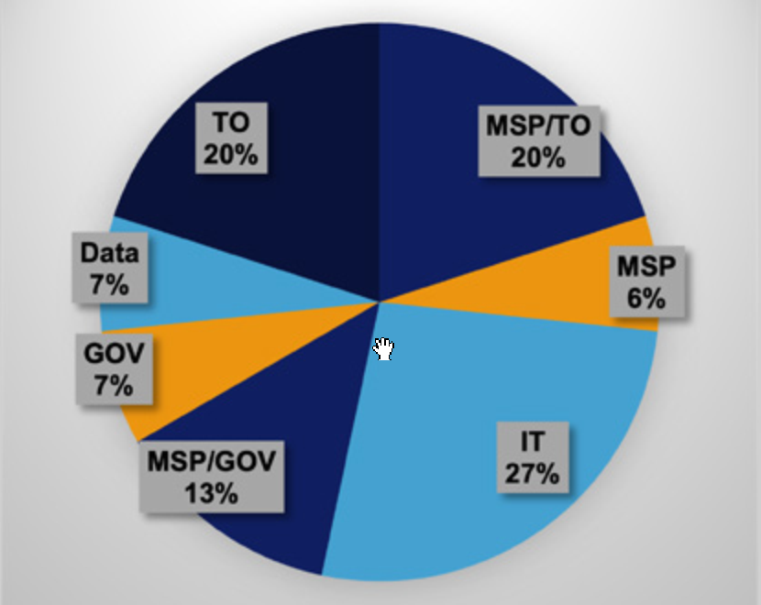
Response
77 European organizations approached
15 responses
12 live interviews
3 responses by mail or phone
response by type of organization

Slide 6
Market sentiment
Overall sentiment
Interests and revenue models
Technical aspects
Strategic aspects

Slide 7
Market sentiment - general sentiment
Generally positive
Uncertainty and critique

Slide 8
Market sentiment - Interests and revenue models
Designers
Governments
Accessibility, sustainability, safety and level playing field towards the market
Encourage public transportation and shared mobility
Carriers
Public transport parties - primary interest: increase customer base
Shared-mobility providers - commercial interest, nationwide coverage
Taxi companies - compete with Uber
Facilitators
MaaS providers - booking and payment, implementation convenience
Software vendors

Slide 9
Market sentiment - Technical aspects
Documentation
Good documentation
Support
Feedback varies
Architecture
Strong, but suggestions exist
Backward compatibility
users vs. non-users

Slide 10
Market sentiment - Strategic aspects
CEN
Track record
Fear of slow progress
Funding
Certification and licensing for use
From EU trajectories, cf. Gaia-x
Parties not fundamentally opposed to payment
Requested contribution must be reasonable
Added value of using standard must be clear
Uncertainty
MaaS has yet to deliver on its promise
Role of government
Common recurring theme: more support needed from government
Need for government to provide direction

Slide 11
Recommendations
Offer clarity (The standard? What does it provide?)
Create an appropriate MaaS ecosystem with shared value proposition (with government as catalyst)
Arrange control and coordination (again, ideally the government)
Develop a technical roadmap
Organize funding

Slide 12
In conclusion
TOMP absolutely has a right to exist!
Good fatherhood is crucial
Thanks to support NDW!

